Slide 1

HEALTHCARE PROJECT
GROUP 21
Ahmed Mohammed Dabbous
Bhargava Bhamidipati
Devashish Singha Roy
Sofia Padovani Plazzi
Notes:
1 - Bhargava

Slide 2
SUMMARY
INTRODUCTION
Problem
Dataset
Aim
Techniques
DATA EXPLORATION
DATA PREPROCESSING
MODEL IMPLEMENTATION & GRID SEARCH
EVALUATION & RESULTS
DISCUSSION & CONCLUSION
Notes:
1 - Bhargava

Slide 3
INTRODUCTION
PROBLEM: Diabetes is a worldwide disease that can cause severe consequences if not rapidly diagnosed and treated.
DATASET: For this study, we will use a dataset composed of 8 numerical features and one binary label column representing some of the main indicators of diabetes in an individual.
AIM: The goal is to train a model to recognize the presence or absence of diabetes.
TECHNIQUES: For this study, we will employ different techniques, from data observation and pre-processing to ML techniques for model implementation.
Notes:
1 - Bhargava

Slide 4
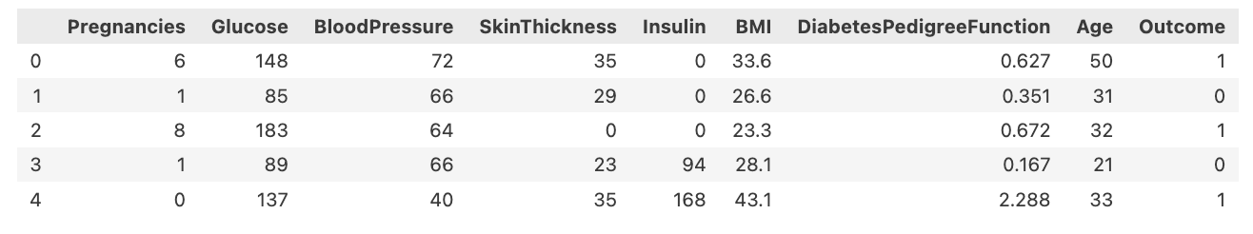
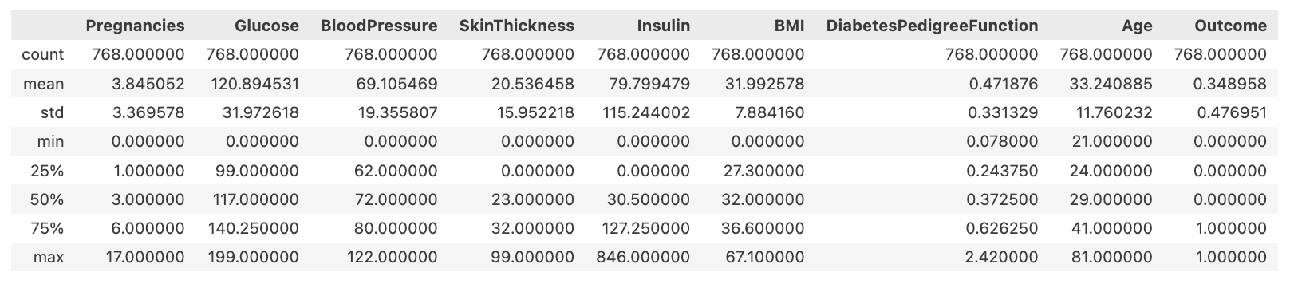
DATA EXPLORATION
Features
Labels
Notes:
2 - Sofia

Slide 5
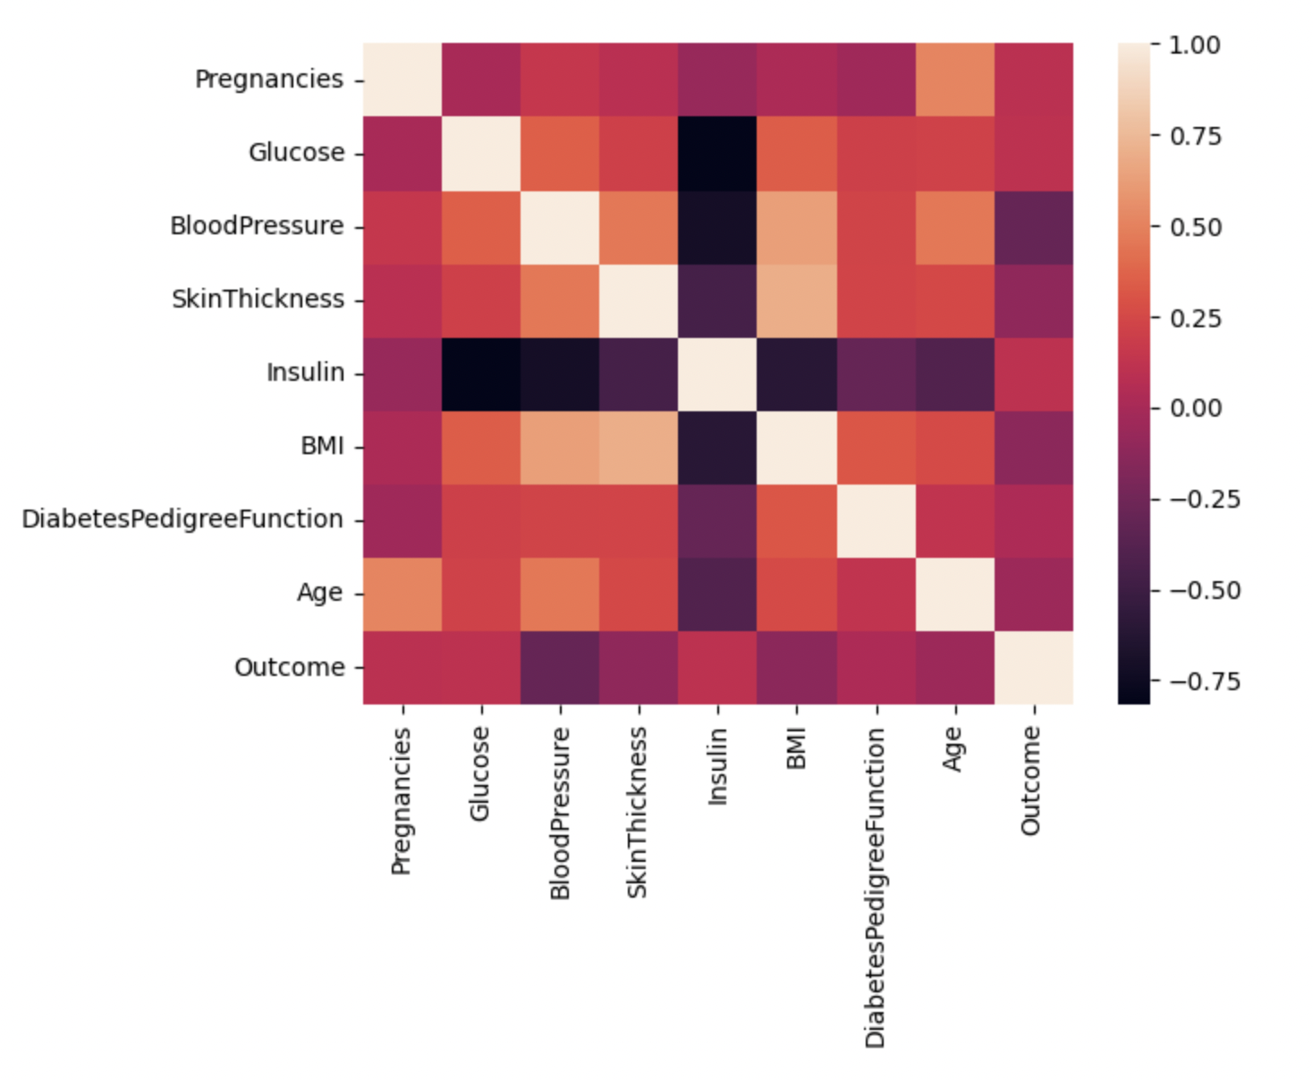
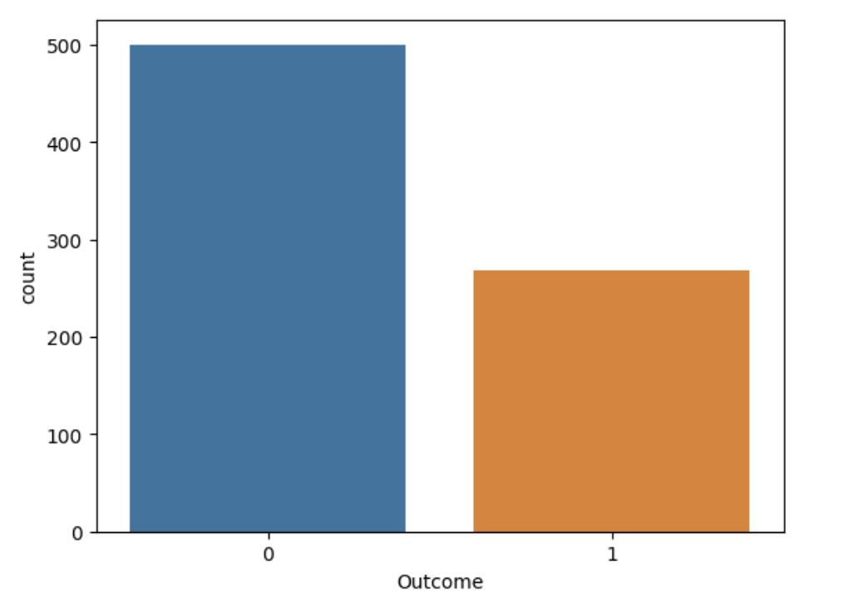
DATA EXPLORATION
By observing the correlation matrix on the right, it can be noticed that some features are correlated, like Insulin and Glucose or BMI and SkinThickness.
As can be observed from the plot on the left, there are imbalanced data compared to the label.
Biased toward major class
Poor Generalization, etc.
Notes:
2 - Sofia

Slide 6
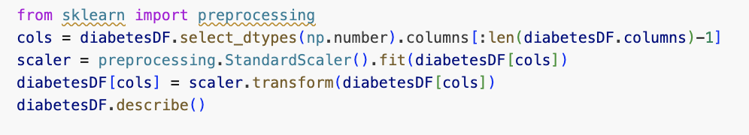
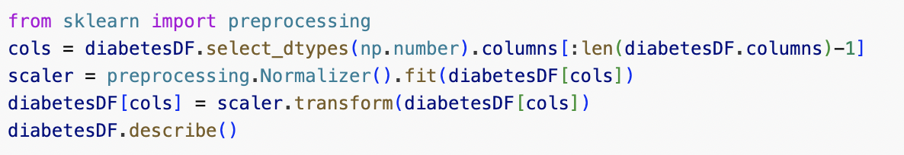
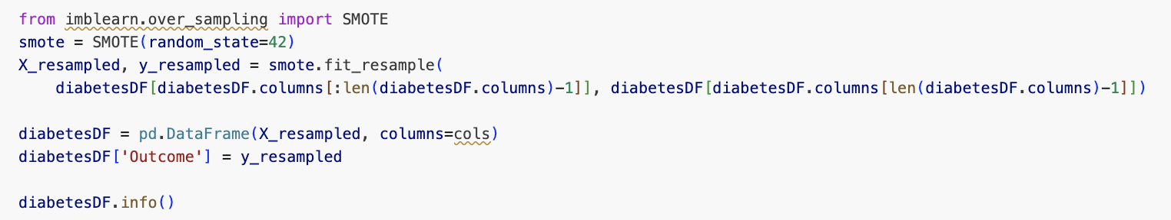
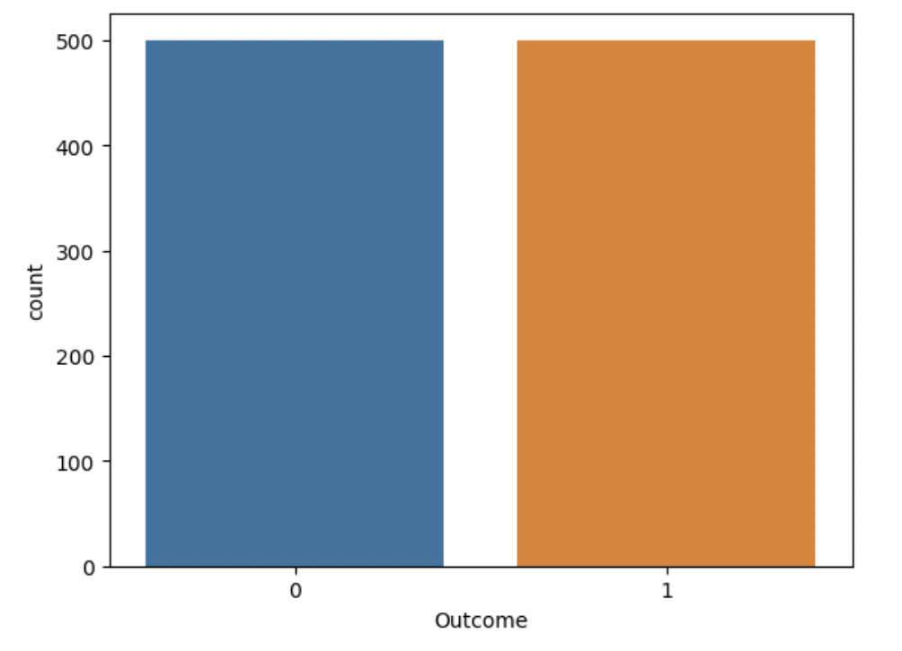
DATA PRE-PROCESSING
STANDARDIZATION:
or
NORMALIZATION:
BALANCED DATA:
Notes:
3 Ahmed

Slide 7
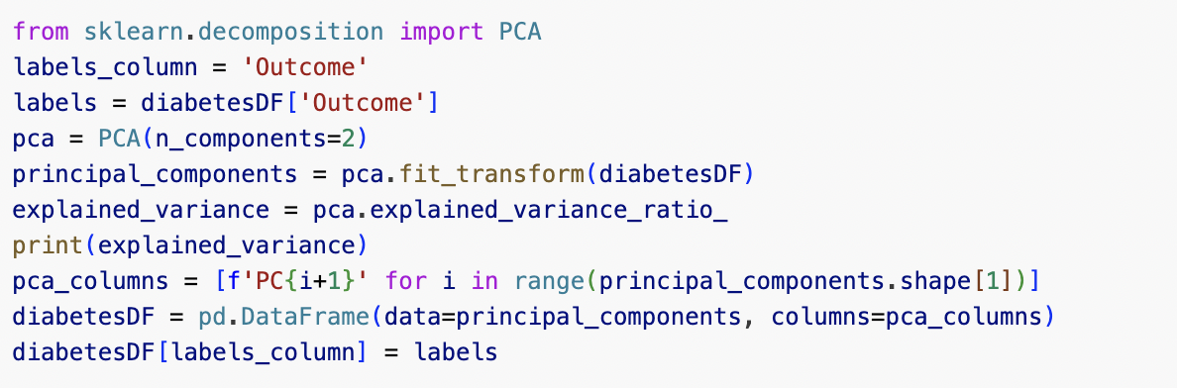
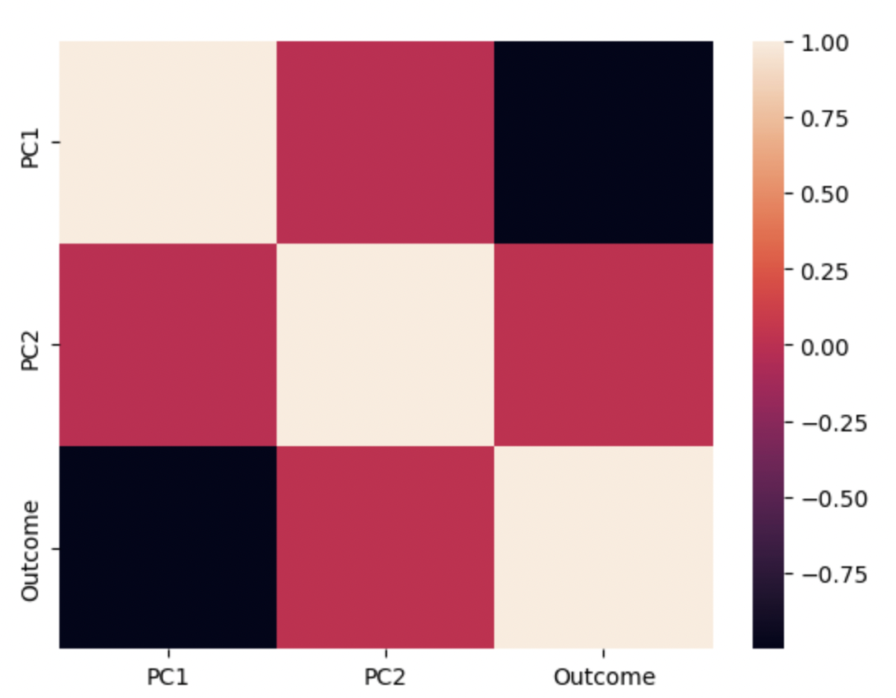
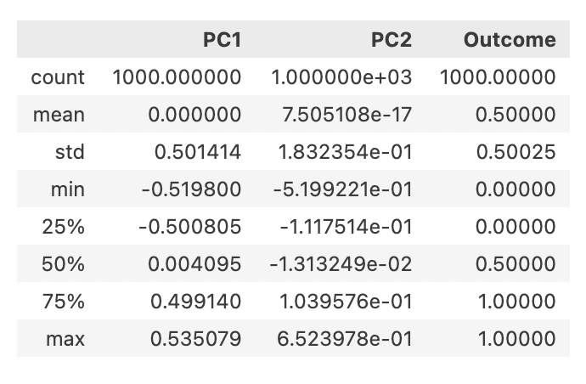
DATA PRE-PROCESSING
PCA:
SPLIT DATA:
Notes:
3 Ahmed

Slide 8
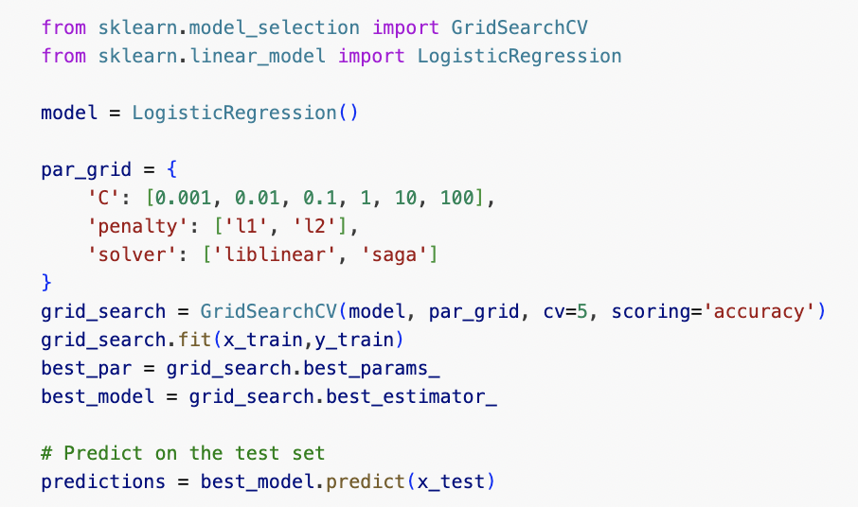
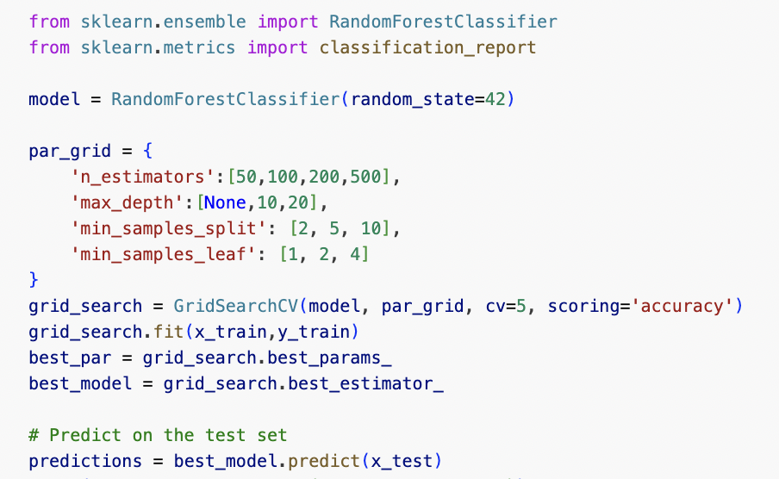
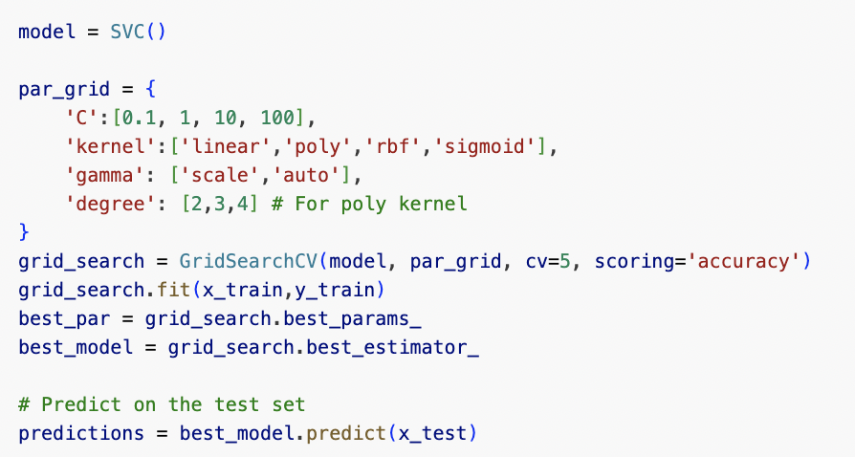
MODEL IMPLEMENTATION & GRID SEARCH
WHY LOGISTIC REGRESSION?
Simple
Interpretable
Designed for Binary Outcome
WHY RANDOM FOREST?
Non-Linear relationships
Robust to Overfitting
Variance Reduction
WHY SVM?
High Dimensions
Robust to Overfitting
Non-Linear Relationships
Grid Search
Notes:
4 - Dev

Slide 9
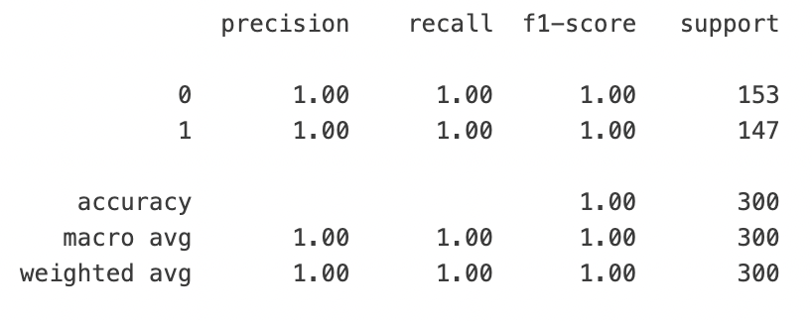
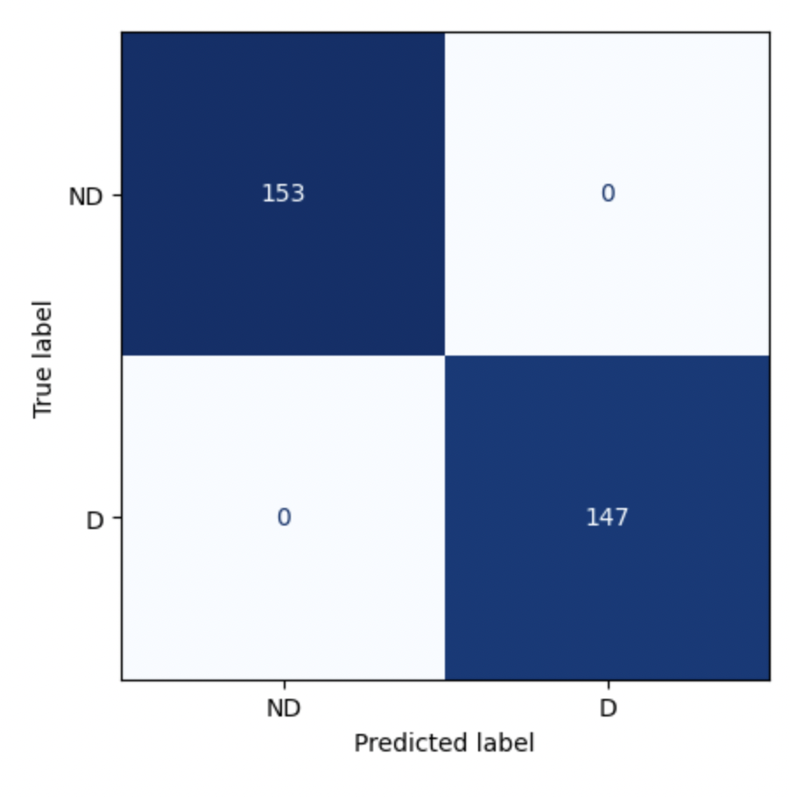
EVALUATION & RESULTS - NORMALIZATION
LOGISTIC REGRESSION
RANDOM FOREST
SVM
Notes:
4 - Dev

Slide 10
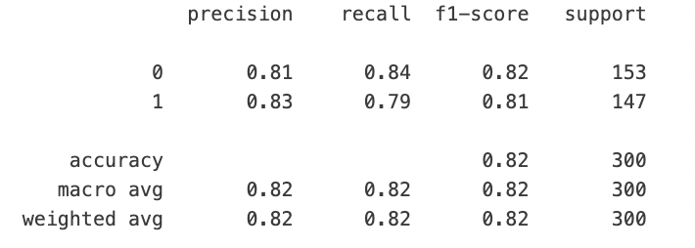
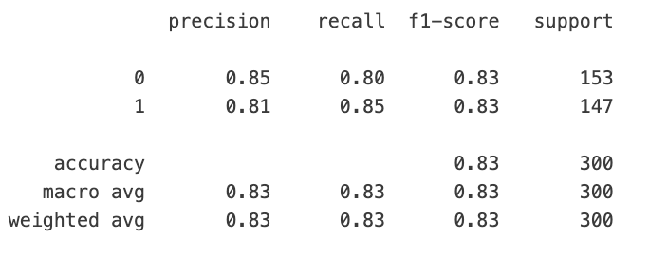
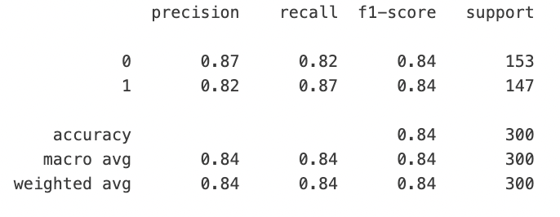
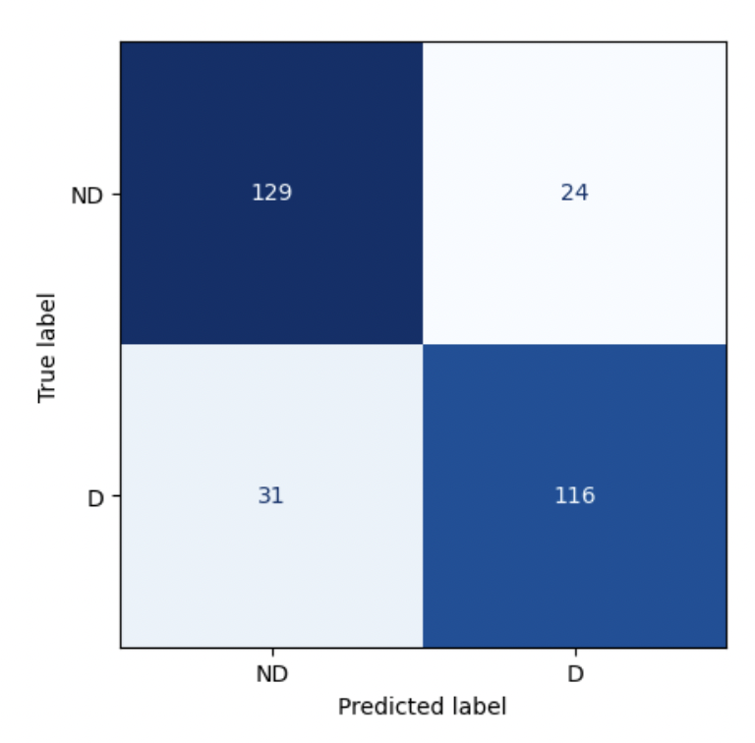
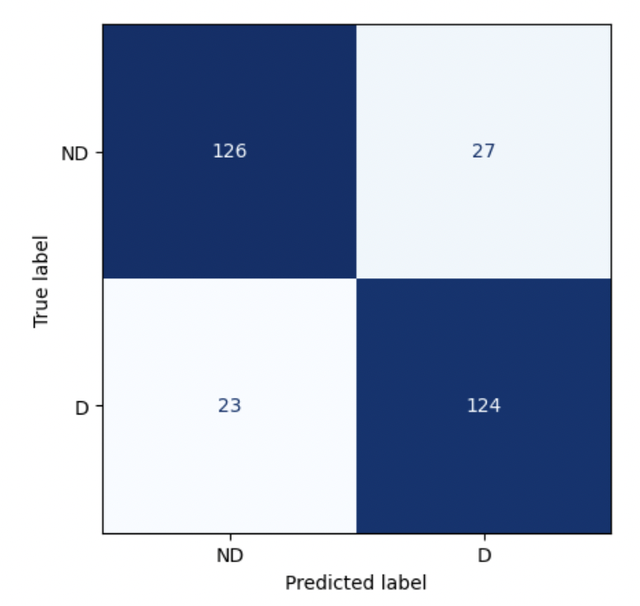
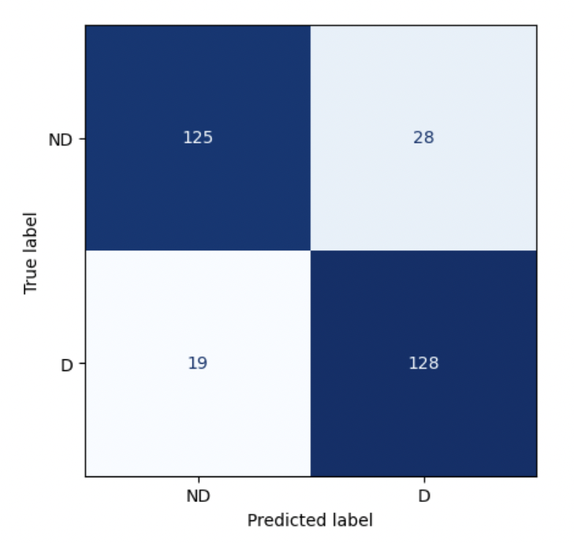
EVALUATION & RESULTS - STANDARDIZATION
LOGISTIC REGRESSION
RANDOM FOREST
SVM
Notes:
4 - Dev

Slide 11
DISCUSSION & CONCLUSION
All the models trained with normalized data performed perfectly compared to all the metrics (precision, recall, accuracy, and f1 score).
REFLECTIONS:
Normalization worked better than standardization as the distribution of data was unknown and probably not normal.
PCA was essential in achieving a high-performance score. This is because it deals with multicollinearity as well as reduces the dimensionality, with which the models can struggle with.
Notes:
1 - Bhargava

Slide 12
THANK YOU!

